Slide 1
Practical – 1
Machine Learning

Slide 2
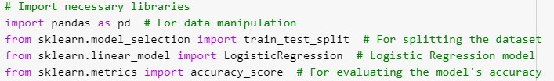
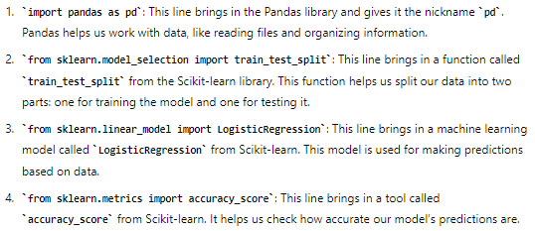
1-A:- Design a simple machine learning model to train the training instances and test the same.
pandas is used for data manipulation, It can read data from different sources like CSV files, Excel spreadsheets, SQL databases, and more.
Scikit-learn (sklearn) is a tool in Python used to build and use machine learning models. It helps you easily create and use machine learning models. It includes different types of models for various tasks like predicting or classifying data. It helps prepare your data so that your models work better. It has tools to check how good your models are.

Slide 3

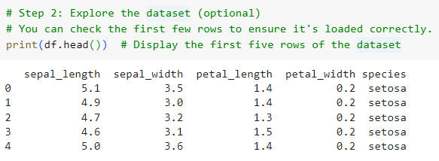
Here, we have to copy the path of the file and load the dataset from a CSV file. df is the name which we have given, It uses Pandas “pd” to read data from a file named iris.csv and stores it in a variable called df.
print(df.head()): This line shows the first five rows of the data in df (the table you loaded from the iris.csv file). It helps you quickly check if the data is loaded correctly and see a sample of what it looks like.

Slide 4

X = df[['sepal_length', 'sepal_width', 'petal_length', 'petal_width']]: This line picks out the columns for sepal length, sepal width, petal length, and petal width from the df table and stores them in X. These are the features or inputs used to make predictions.
y = df['species']: This line selects the species column from df and stores it in y. This is the target variable or the output we want to predict based on the features.
X_train, X_test, y_train, y_test = train_test_split(X, y, test_size=0.2, random_state=42):
This line splits the data into two parts:
X_train and y_train: These contain the features and target variable used to train the model.
X_test and y_test: These contain the features and target variable used to test how well the model performs.
test_size=0.2 means 20% of the data is used for testing, and random_state=42 means, no matter what number you give eg: either 42 or 43, still the 80 of the data should go in train and 20 will go in test. Its just like a verification.

Slide 5
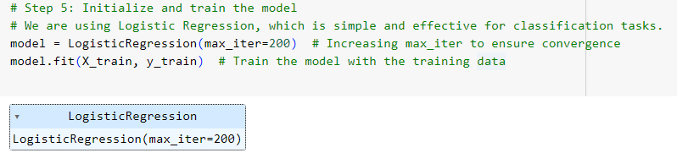
model = LogisticRegression(max_iter=200): This line creates a Logistic Regression model. The parameter max_iter=200 sets the maximum number of iterations the algorithm will run to find the best model. Increasing it ensures that the model has enough time to find a good solution.
model.fit(X_train, y_train): This line trains the model using the training data (X_train for the features and y_train for the target variable). The model learns from this data so that it can make predictions on new data later.
Here, we have created a model using logistic regression. Now, before deploying the model; we will first train the model (preparing for the interviews by seeing youtube, etc) and test the model (give mock test before getting sure that you are eligible to sit for the interview).

Slide 6
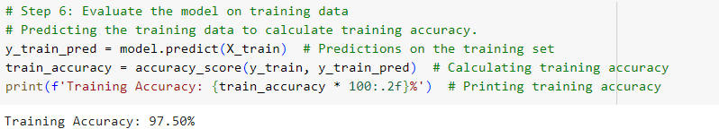
y_train_pred = model.predict(X_train): This line makes predictions using the trained model on the training data (X_train). The model tries to predict the target variable (y_train) based on the features in the training set.
train_accuracy = accuracy_score(y_train, y_train_pred): This line calculates how accurate the model's predictions are on the training data. It compares the actual target values (y_train) with the predicted values (y_train_pred) and computes the accuracy score.
print(f'Training Accuracy: {train_accuracy * 100:.2f}%'): This line prints the training accuracy as a percentage, showing how well the model performed on the training data. The :.2f ensures that the percentage is shown with two decimal places.

Slide 7
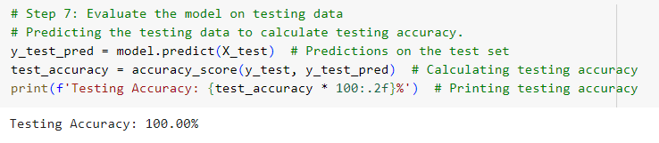
y_test_pred = model.predict(X_test): This line makes predictions using the trained model on the test data (X_test). The model tries to predict the target variable (y_test) based on the features in the test set.
test_accuracy = accuracy_score(y_test, y_test_pred): This line calculates how accurate the model's predictions are on the test data. It compares the actual target values (y_test) with the predicted values (y_test_pred) and computes the accuracy score.
print(f'Testing Accuracy: {test_accuracy * 100:.2f}%'): This line prints the testing accuracy as a percentage, showing how well the model performed on the unseen test data. The :.2f ensures that the percentage is shown with two decimal places.

Slide 8
1-B:Implement and demonstrate the FindS algorithm for finding the most specific hypothesis based on a given set of training data samples. Read the training data from a CSV file.

Slide 9
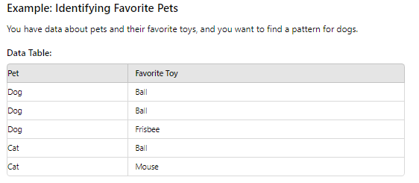
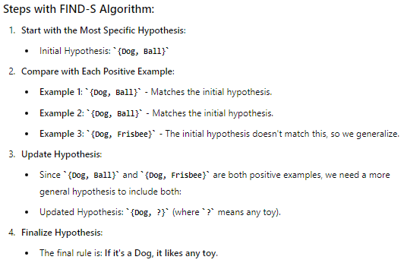
FIND-S Algorithm

Slide 10
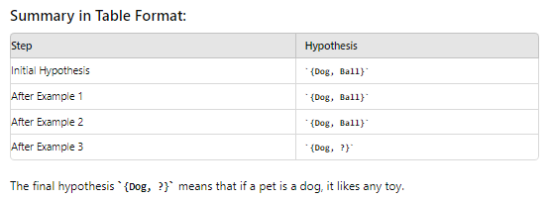
FIND-S Algorithm

Slide 11
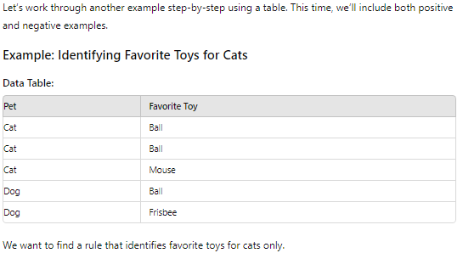
FIND-S Algorithm

Slide 12
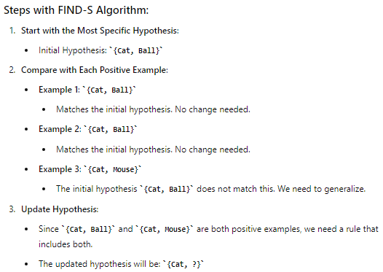
FIND-S Algorithm

Slide 13
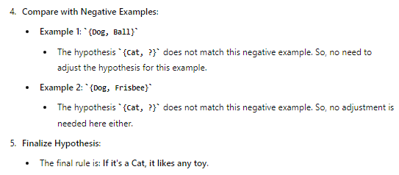
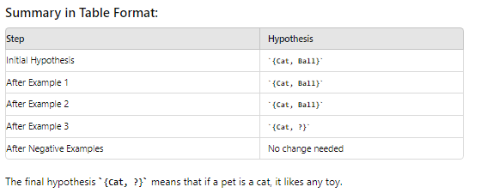
FIND-S Algorithm

Slide 14
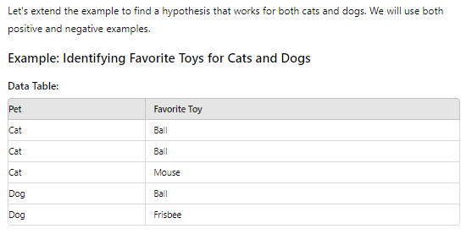
FIND-S Algorithm

Slide 15
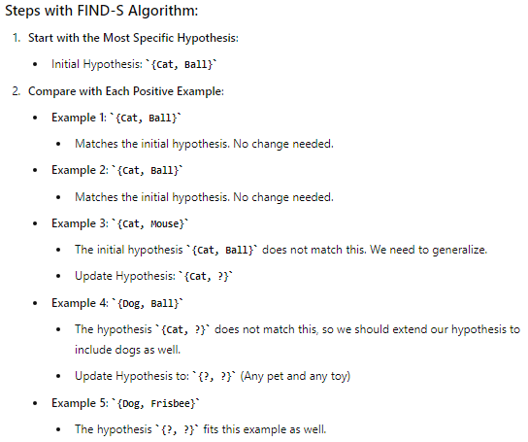
FIND-S Algorithm

Slide 16
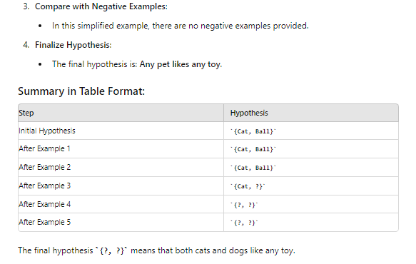
FIND-S Algorithm

Slide 17
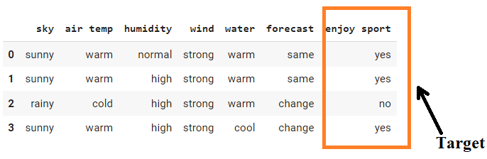
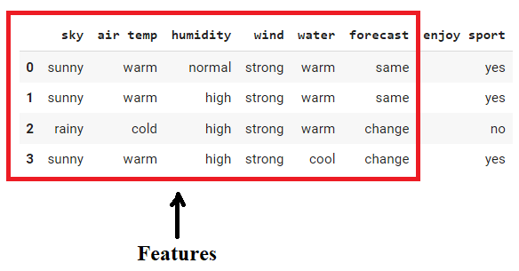
This is how the dataset of Practical 1-b is:-

Slide 18

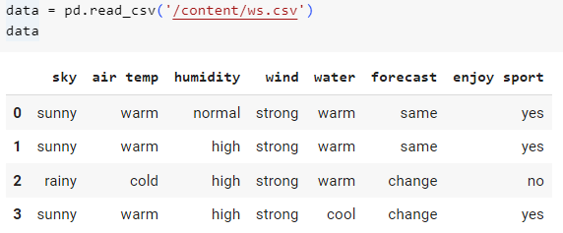
import pandas as pd: Imports the pandas library and assigns it the alias pd, which is used for data manipulation and analysis.
import numpy as np: Imports the numpy library and assigns it the alias np, which is used for numerical operations with arrays and matrices.
pd.read_csv(): This function reads a CSV file and returns it as a DataFrame.
'/content/ws.csv': The path to the CSV file you want to read.
data: A variable that stores the DataFrame created from the CSV file.

Slide 19
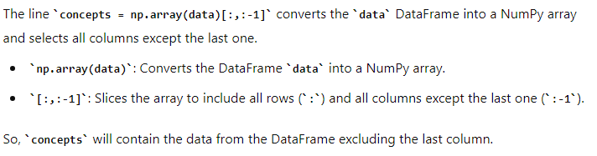
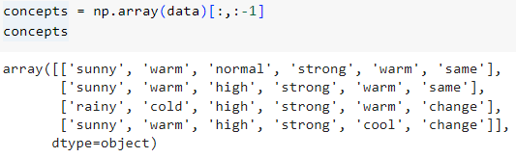

Slide 20
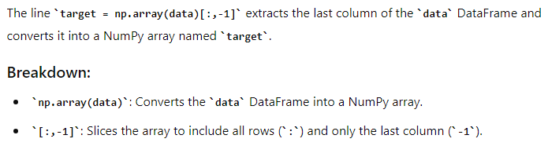


Slide 21
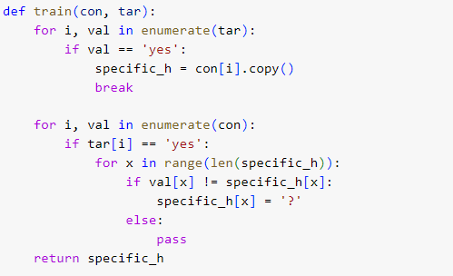
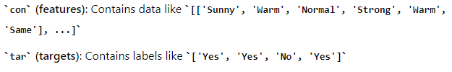

Slide 22

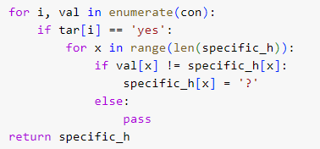
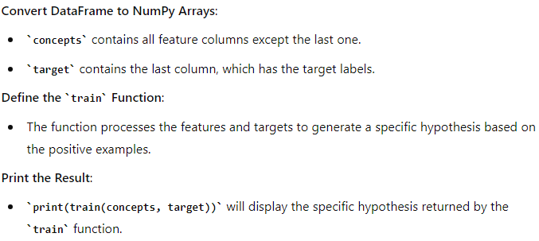
Finds the first feature vector where the target label is 'yes' and sets specific_h to this feature vector.
For each feature vector where the target label is 'yes’:
Compare it to the current specific_h.
If a feature value in the current vector does not match specific_h, replace that feature value in specific_h with a ?.
Returns the refined hypothesis which represents the rule that matches all positive examples as closely as possible.

Slide 23
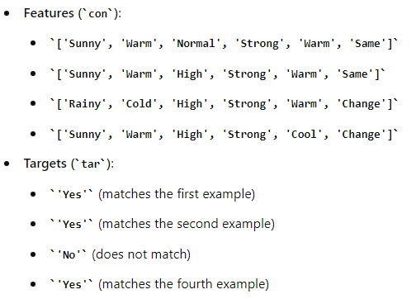
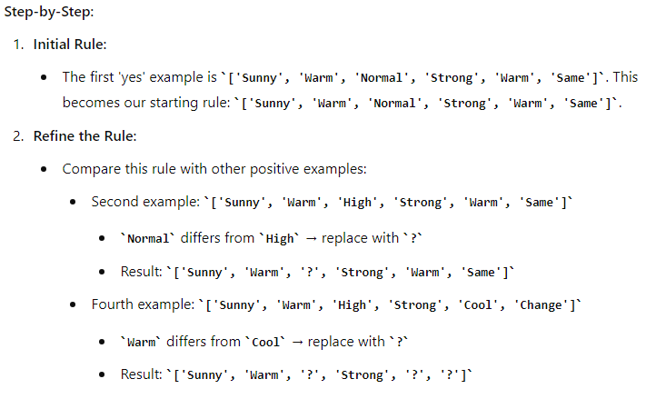

Slide 24
